Slide 1
Periodic Trends: Metallic Character

Slide 2
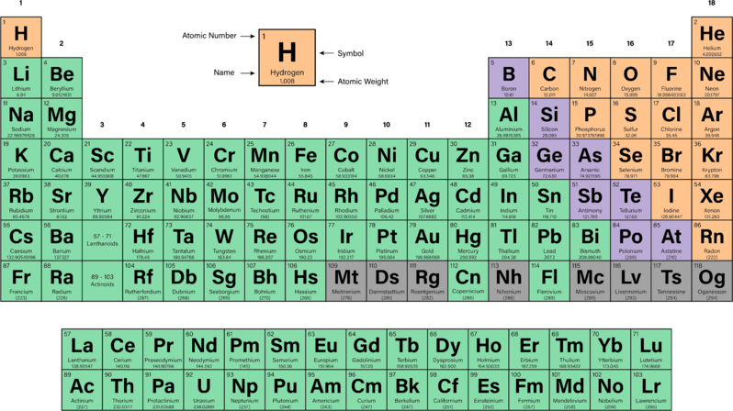
In this Smart Lesson you will learn:
• | What causes elements to be metallic or non-metallic.
• | How this character can be explained by the electron configuration of an element.
• | That the metallic or non-metallic character of an element can be determined based on its position in the periodic table.

Slide 3
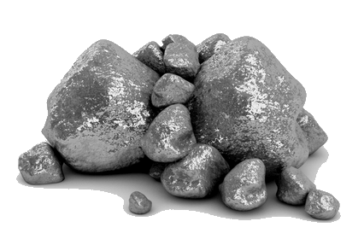
Another trend in the periodic table is metallic character. This refers to how metallic an element is, based on other properties such as electrical and thermal conductivity, and how easily it can be bent.
Most of the properties of a metal can be explained by how strong the attraction between the nucleus and electrons is.
For example electrical conductivity can be explained as electrons being able to move through metal. The less attraction between the electrons and nucleus the more conductive a metal is.

Slide 4
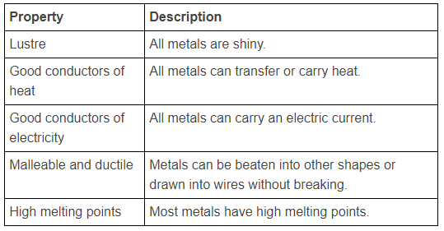
Metals all have the following properties:

Slide 5
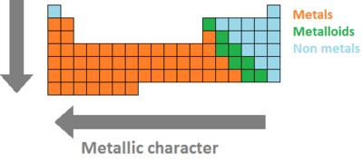
The metallic character decreases across a period and increases going down a group. The "most metallic" elements are located at the bottom-left of the periodic table.
The periodic table can also be divided into metals, non-metals and metalloids which have both metal and non-metal characteristics.

Slide 6
When going across a period the metallic character of elements decreases. This is because the valence electrons stay in the same electron shell, but more protons are added to the nucleus. This in turn causes electrons to be more attracted to the nucleus.
When going down a group the metallic character of elements increases. This is because of the additional electron shells which place the valence electrons farther from the nucleus. Subsequently this reduces the attraction between the electrons and the nucleus.

Slide 7
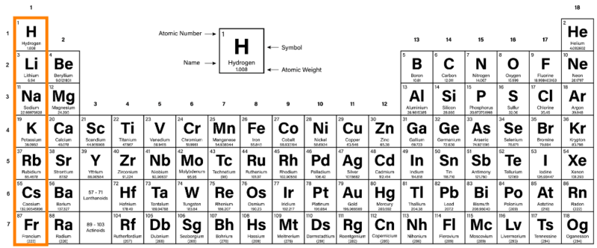
The first Group of the periodic table is the alkali metals. These are on the far left of the table (Group I) and show mostly typical metallic properties. Hydrogen is often drawn at the top of this group, as it has one valence electron, but it is NOT an alkali metal and has very different properties.

Slide 8


Group 1 elements are known as the alkali metals.
All alkali metals are highly reactive and, due to having 1 valence electron, form ions with a charge of +1.
Reactivity increases as you move down the group. This is because the valence electrons are getting further from the nucleus, and are easier to remove.
The alkali metals are lithium (Li), sodium (Na), potassium (K), rubidium (Rb), cesium or caesium (Cs) and francium (Fr, not covered in this lesson).

Slide 9

Alkali metals are very soft and you can cut most of them with a knife.
Alkali metals react violently with water. Any alkali metals stored in your school will probably be completely submerged in oil to avoid unwanted reactions.

Slide 10
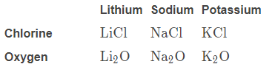
Alkali metals will react to produce similar compounds.
For example:
They will all react with chlorine to form ionic compounds with the formula XCl, where X is an alkali metal.
They will all react with oxygen to form ionic compounds with the formula X₂​O, where X is an alkali metal.

Slide 11
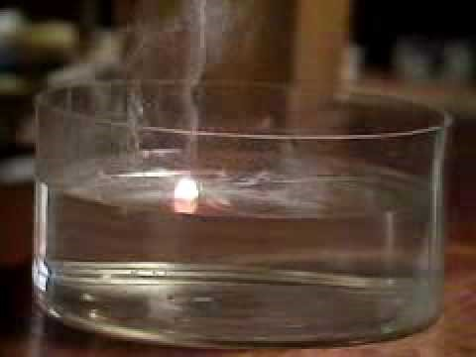

Slide 12

Group 17 elements are known as halogens. As they are found on the right side of the periodic table, they are non-metals, so do not show metallic properties.
Halogens are quite reactive. Halogens have 7 valence electrons, and can form 1 covalent bond (share 1 electron), or ions with a charge of −1 (take 1 electron).
Reactivity decreases as you move down the group. This is because the electronegativity decreases as the outer shell gets further away.
The halogens are fluorine (F), chlorine (Cl), bromine (Br), iodine (I) and astatine (At, not covered in this lesson).

Slide 13
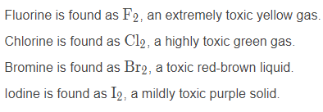
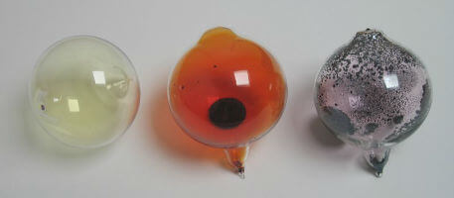
Halogens all bond covalently to form diatomic molecules (molecules with two atoms). Halogens are typically coloured, and toxic.

Slide 14
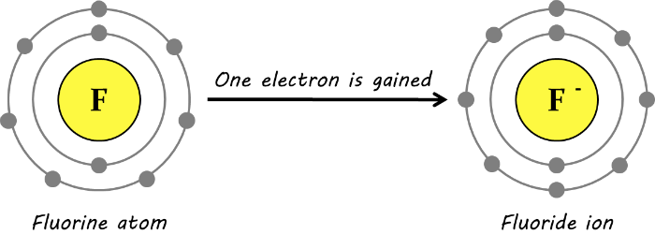
Halogens can bond covalently or ionically; they can form 1 covalent bond (by sharing 1 electron), or an ion with a charge of −1 (by taking 1 electron).

Slide 15
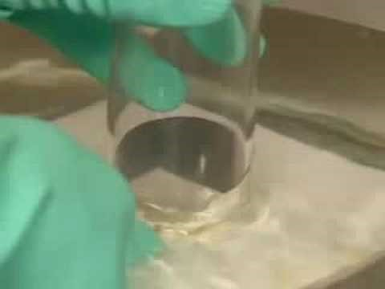

Slide 16

Halogens are reactive because they are only 1 electron from fulfilling the octet rule, and have the electronegativity to easily gain this electron.
Halogens are toxic because they can react with most of the chemical compounds in your body! This is why the most reactive halogens are the most toxic.

Slide 17
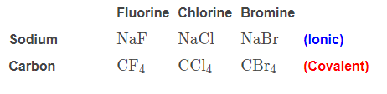
Halogens all form similar compounds.
For example:
Halogens will react with sodium to form an ionic compound with the formula NaX, where X is any halogen.
Halogens will react with carbon to form a covalent compound with the formula CX₄​, where X is any halogen.

